Slide 1
Emotional Interaction
Sara Muneeb
sara.muneeb@cuilahore.edu.pk
Computer Science Department

Slide 2

Introduction
Designing technology to detect and recognize someone’s emotions automatically is often called emotional AI or affective computing.
Emotional design is the design of technology that can engender desired emotional states, for example, apps that enable people to reflect on their emotions, moods, and feelings
Emotional Interaction = Emotional Design + Affective Computing

Slide 3
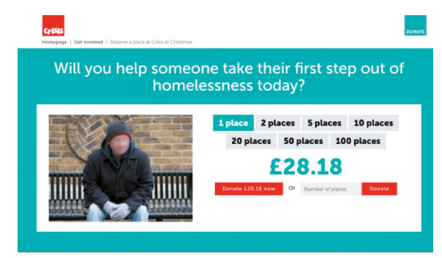
Emotion and User Experience
Emotional interaction is concerned with what makes people feel happy, sad, annoyed, anxious, frustrated, motivated, delirious, and so on, and then using this knowledge to inform the design of different aspects of the user experience.

Slide 4
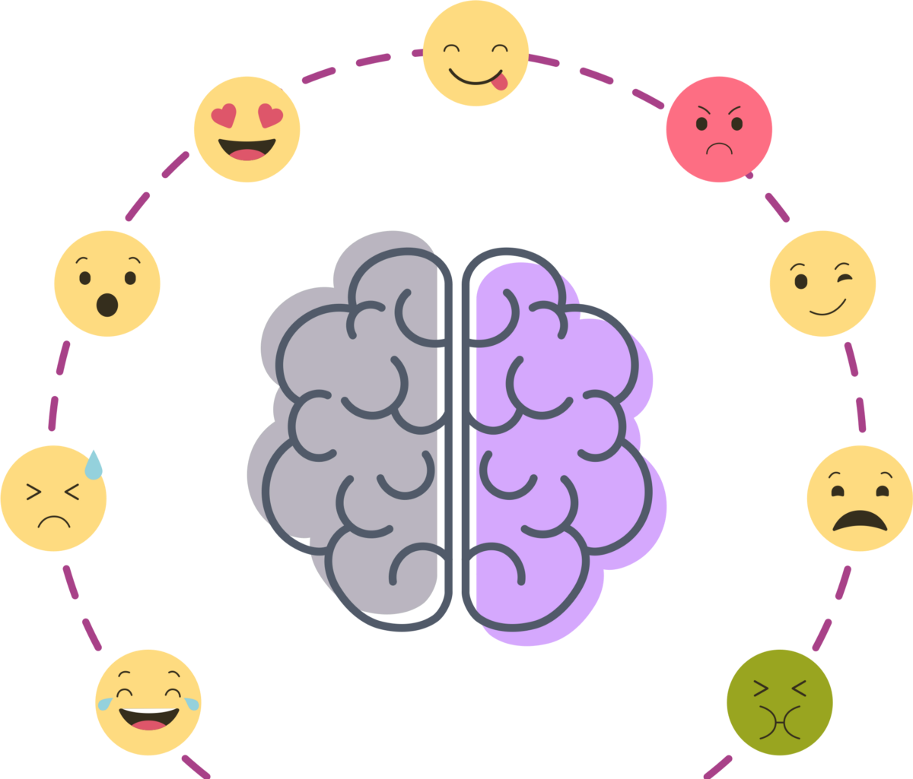
Emotions
Change in mood and feeling is continuous therefore it is often difficult to predict how we will feel at different times.
To understand how emotions affect behavior and how behavior affects emotions we should examine how people express themselves and read each other’s expressions.
Understanding of relationship between facial expressions, body language, gestures, and tone of voice etc.
Hence the role of emotion is
more complicated than a simple
cause-and-effect model.
(Baumeister et al. (2007)

Slide 5
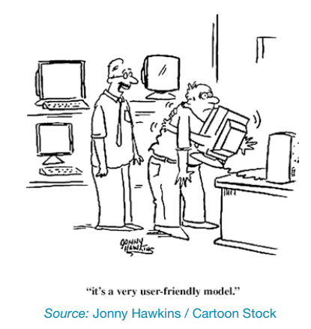
Type of Emotions
Automatic Emotions (aka affect) happen rapidly, typically within a fraction of a second and, likewise, may dissipate just as quickly.
Conscious Emotions (aka reflections) tend to be slow to develop and equally slow to dissipate, and they are often the result of a conscious cognitive behavior, such as weighing the odds or contemplation

Slide 6
Understanding Emotions
Understanding how emotions work provides a way of considering how to design for user experiences that can trigger affect or reflection.
For example: when people are happy, they are more likely to overlook and cope with minor problems. In contrast, when someone is anxious or angry, they are more likely to be less tolerant.
“Things intended to be used under stressful situations require a lot more care, with much more attention to detail” (Norman, 2005, p. 26)

Slide 7
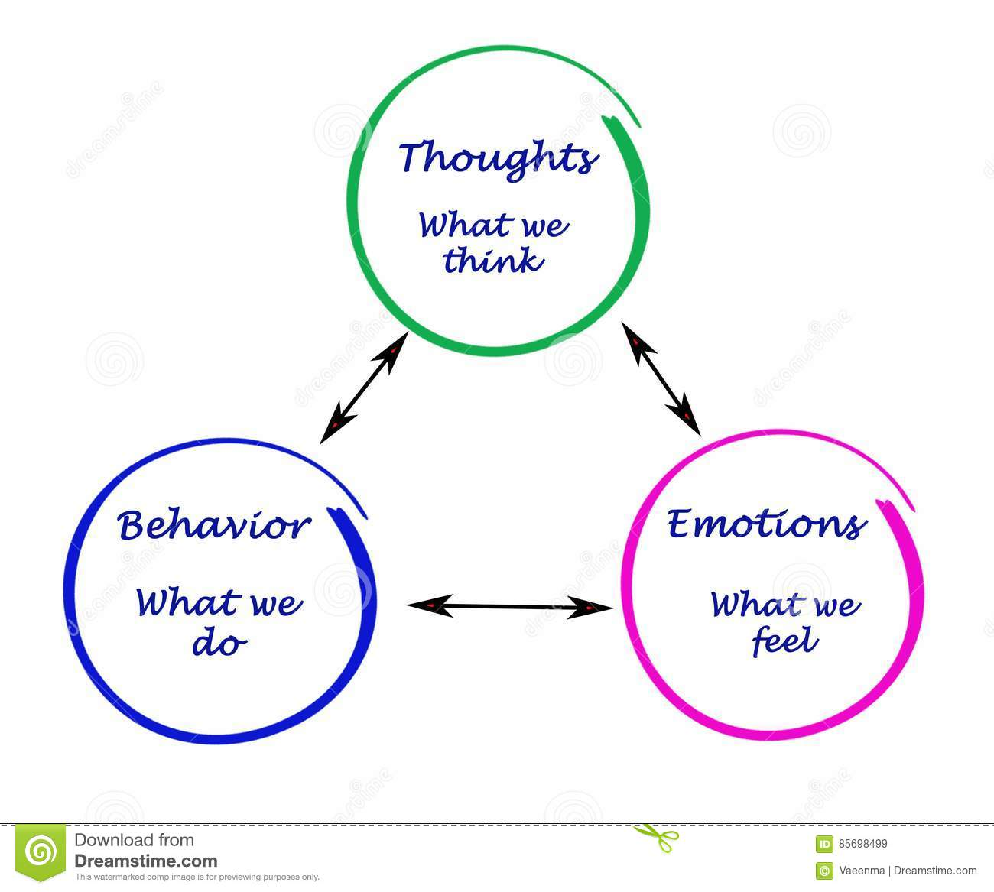
Emotions and Behaviors
Fear brings about flight
Anger initiates the fight
Nervousness is anxiety and fear
Unpleasant experiences
sweating, butterflies in the stomach, quick breathing, heart pounding, and even feelings of nausea.

Slide 8
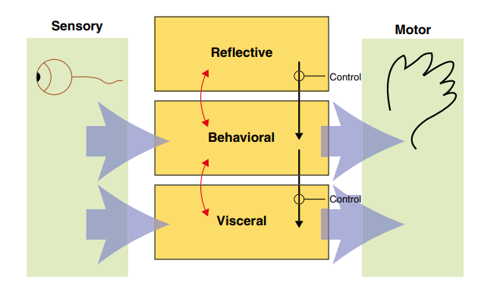
Model of Emotions and Behaviors
This model is couched by the 3 levels of brain.
Visceral level: at the lowest level, the part of the brain that is prewired to respond automatically to events happening in the physical world.
Behavioural level: at the next level, brain processes that control everyday behaviours.
Reflective level: at the highest level, brain processes involved in contemplating.
Anthony Ortony et al.’s (2005)

Slide 9
Levels of Brain
Visceral level responds rapidly
Makes judgments about what is good or bad, safe or dangerous, pleasurable or abhorrent.
Triggers the emotional responses to stimuli (for instance fear, joy, anger, and sadness) For example, many people will experience fear on seeing a lizard.
Behavioural level is where most human activities occur.
Reflective level entails conscious thought where people generalize across events or step back from their daily routines.

Slide 10
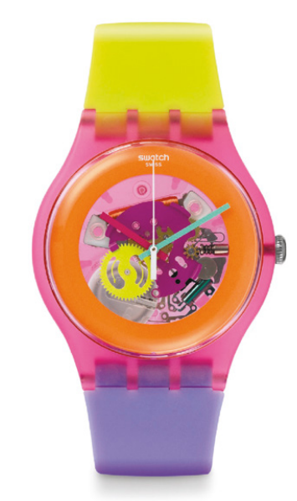
Brain Model and Product Design
Visceral design refers to making products look, feel, and sound good.
Behavioural design is about use and equates to the traditional values of usability.
Reflective design is about considering the meaning and personal value of a product in a particular culture.

Slide 11
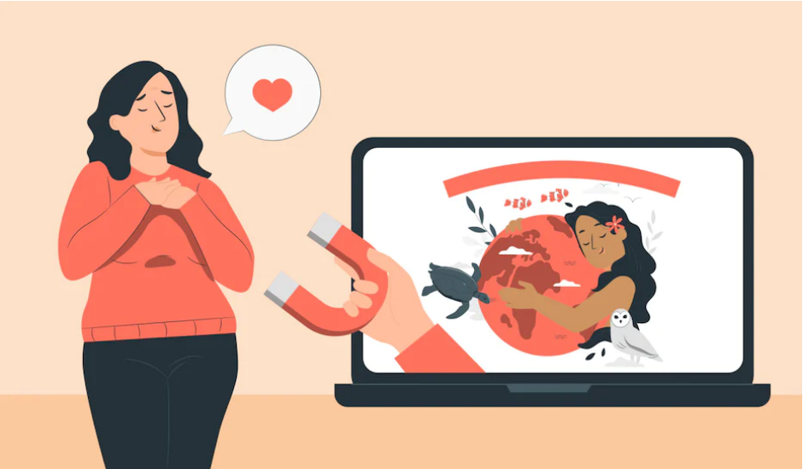
Expressive Interface and Emotional Design
Designers use a number of features to make an interface expressive
Emojis, sounds, colors, shapes, icons, and virtual agents
These feature are used to
create an emotional connection or feeling with the user (for instance, warmth or sadness) and/or
elicit certain kinds of emotional responses in users, such as feeling at ease, comfort, and happiness

Slide 12
Way of Expressivity
Animated icons (for example, a recycle bin expanding when a file is placed in it and paper disappearing in a puff of smoke when emptied)
Sonifications indicating actions and events (such as whoosh for a window closing, “schlook” for a file being dragged, or ding for a new email arriving)
Vibrotactile feedback, such as distinct smartphone buzzes that represent specific messages from friends or family

Slide 13
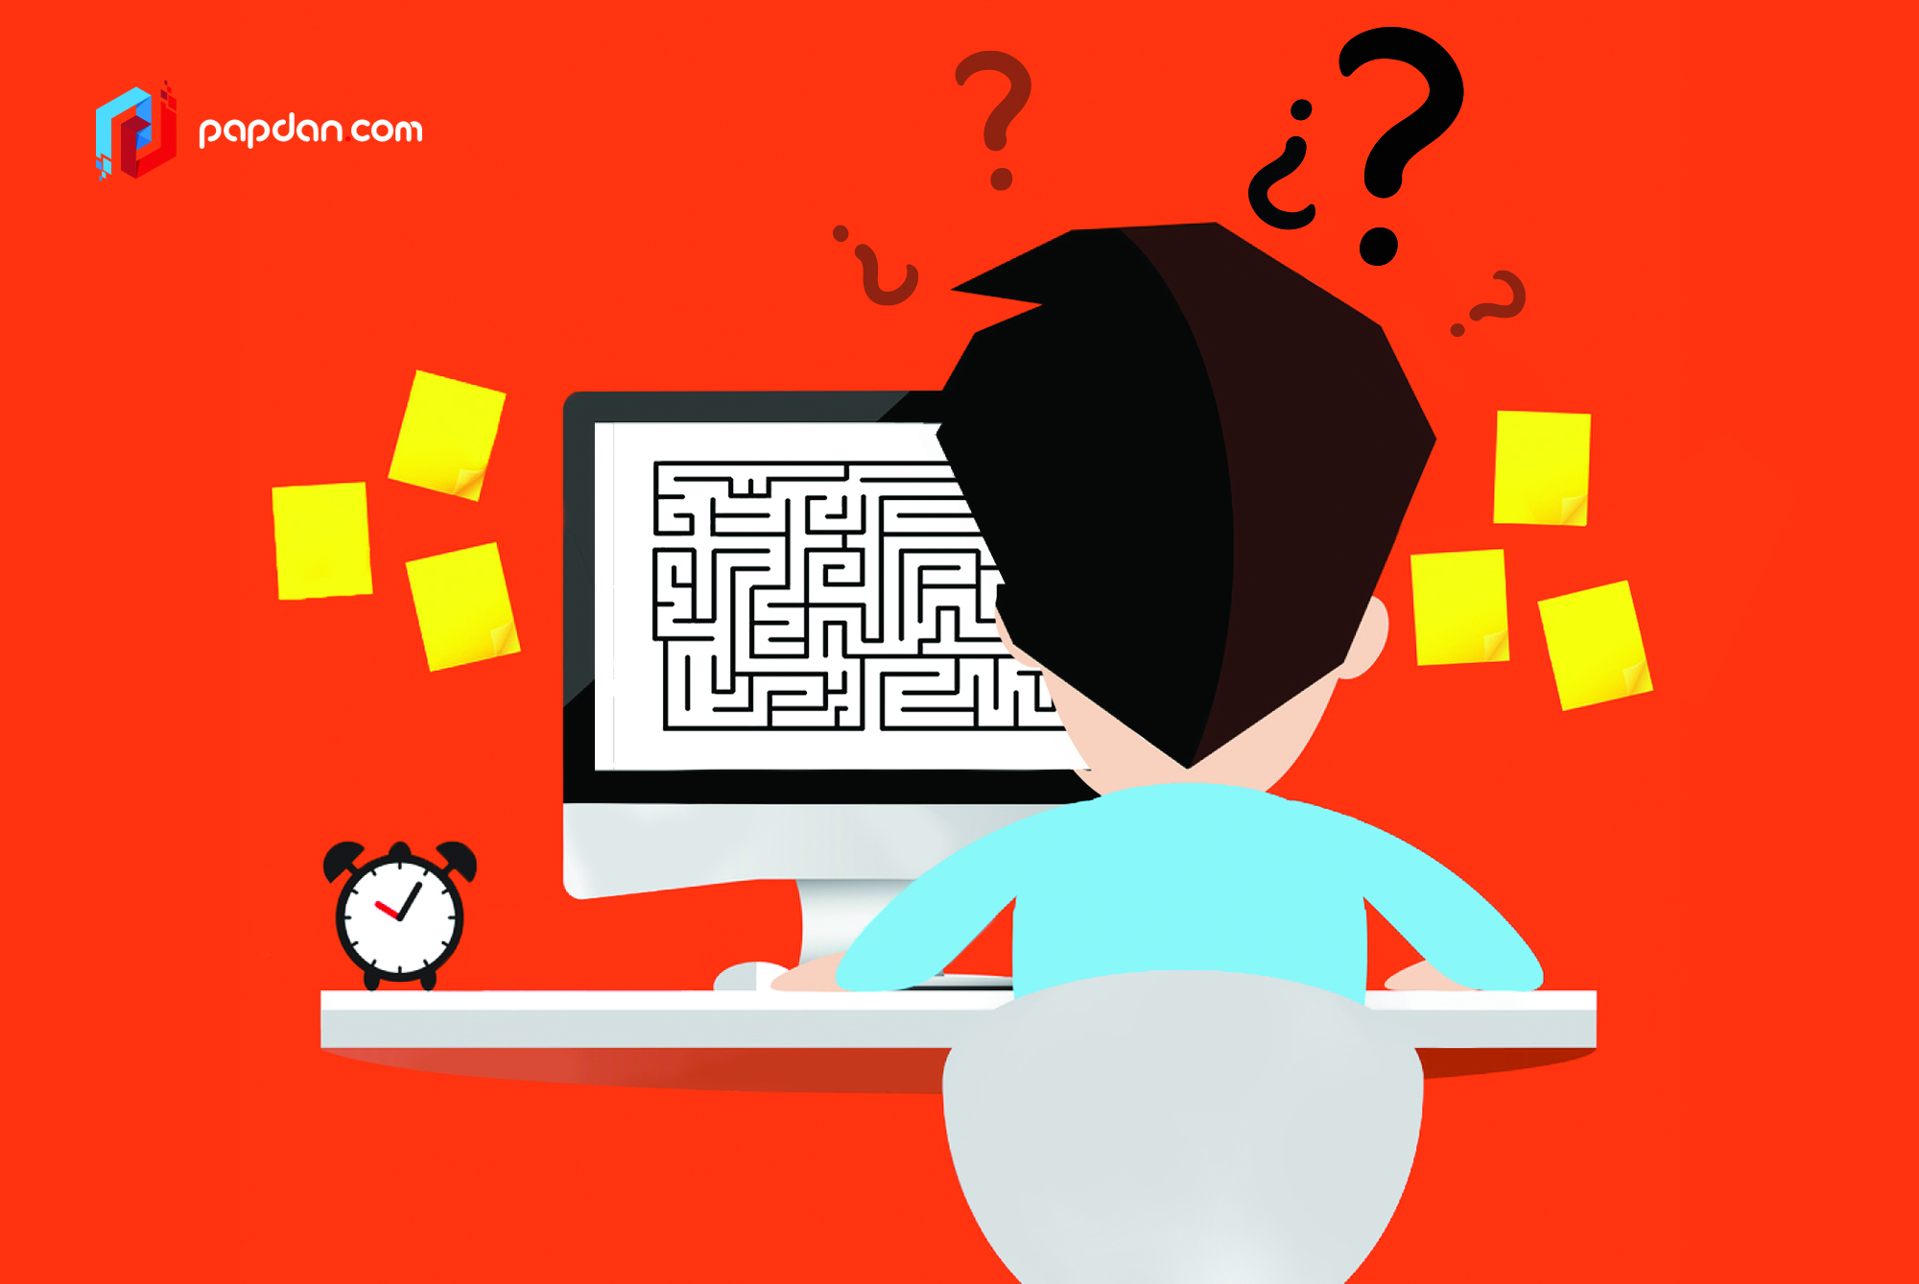
Annoying Interfaces
In many situations, interfaces may inadvertently elicit negative emotional responses, such as anger.
This typically happens when something that should be simple to use or set turns out to be complex.

Slide 14
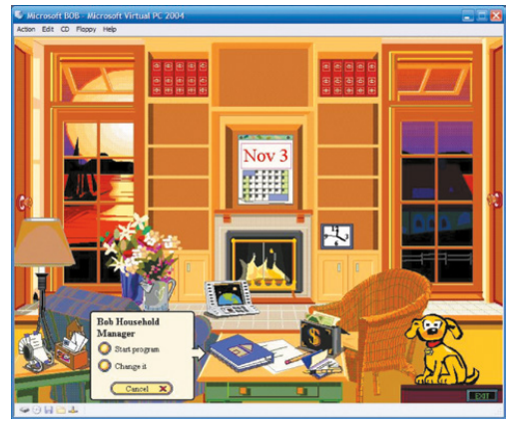
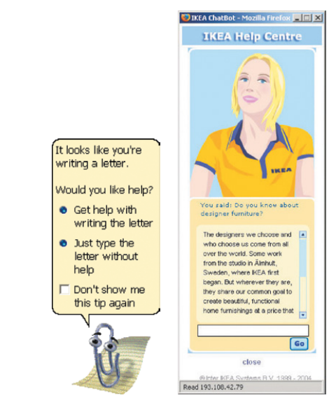
Example
Bob (Win95)
Clippy (Win98)
IKEA’s Anna

Slide 15
Reasons for Negative Emotions
When an application doesn’t work properly or crashes
When a system doesn’t do what the user wants it to do
When a user’s expectations are not met
When a system does not provide sufficient information to let the user know what to do
When error messages pop up that are vague or obtuse
When the appearance of an interface is too noisy, garish, gimmicky, or patronizing

Slide 16
Reasons for Negative Emotions
When a system requires users to carry out too many steps to perform a task, only to discover a mistake was made somewhere along the line and they need to start all over again
Websites that are overloaded with text and graphics, making it difficult to locate desired information and resulting in sluggish performance
Flashing animations, especially flashing banner ads and pop-up ads that cover the user view and which require them to click in order to close them

Slide 17
Reasons for Negative Emotions
The overuse or automatic playing of sound effects and music, especially when selecting options, carrying out actions, running tutorials, or watching website demos
Featuritis—an excessive number of operations, such as an array of buttons on remote controls
Poorly laid-out keyboards, touchpads, control panels, and other input devices that cause users to press the wrong keys or buttons persistently

Slide 18
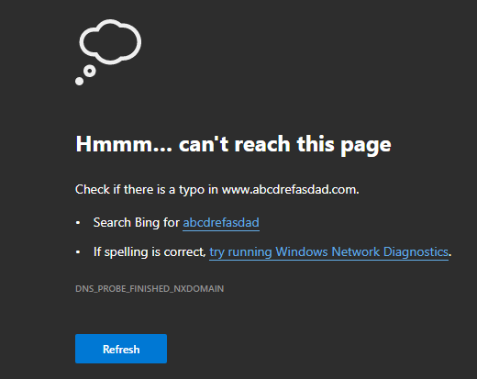
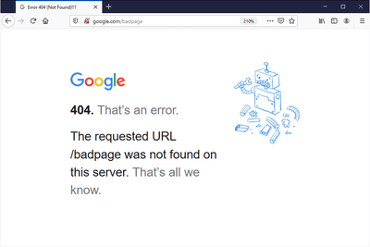
An Example – Error 404

Slide 19

404 Alternate - Example

Slide 20
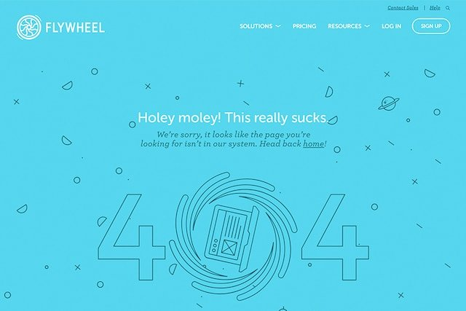
404 Alternate - Example

Slide 21

404 Alternate - Example

Slide 22
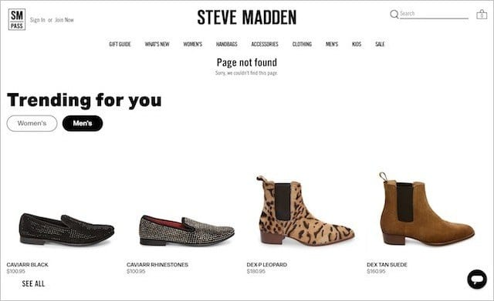
404 Alternate - Example

Slide 23
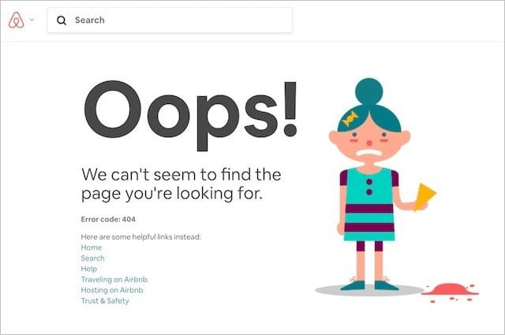
404 Alternate - Example

Slide 24
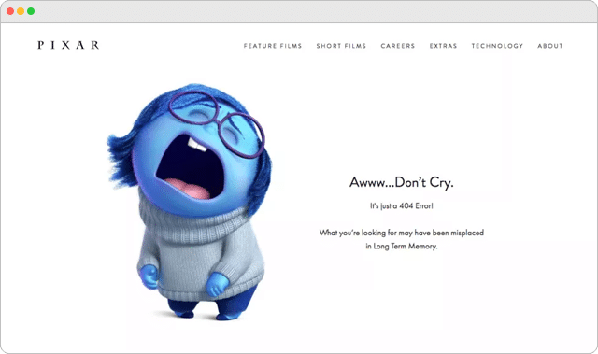
404 Alternate - Example

Slide 25

404 Alternate - Example

Slide 26


Another Example – Unsubscribe

Slide 27


Unsubscribe Alternate – Example

Slide 28
Unsubscribe Alternate – Example

Slide 29
Effective Computing and Emotional AI
Affective computing is concerned with how to use computers to recognize and express emotions in the same way as humans do.
Emotional AI seeks to automate the measurement of feelings and behaviors by using AI technologies that can analyze facial expressions and voice in order to infer emotions.

Slide 30
Where tech comes in?
Cameras for measuring facial expressions
Biosensors placed on fingers or palms to measure galvanic skin response
Affective expression in speech
Body movement and gestures, as detected by motion capture systems or accelero-meter sensors placed on various parts of the body

Slide 31
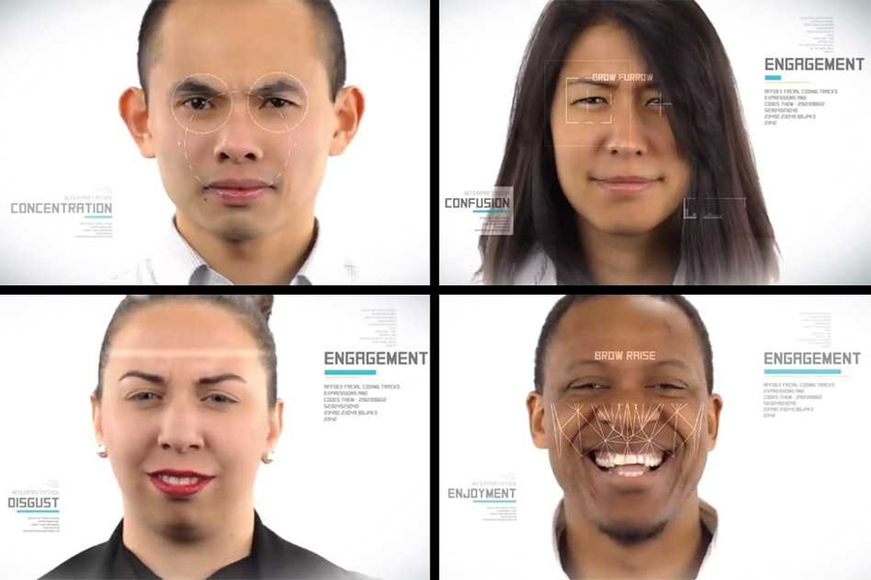
Example - Affdex

Slide 32
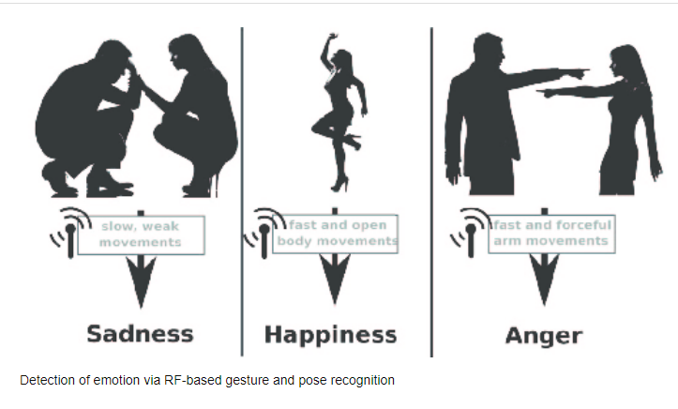
Example – Body Movements

Slide 33
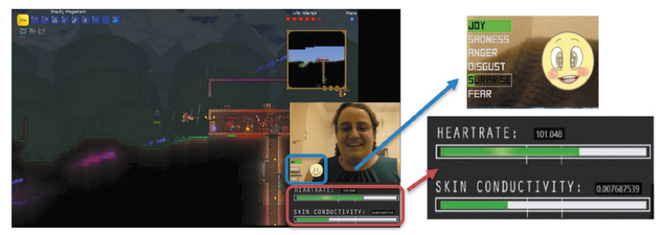
Example – All the Feels

Slide 34
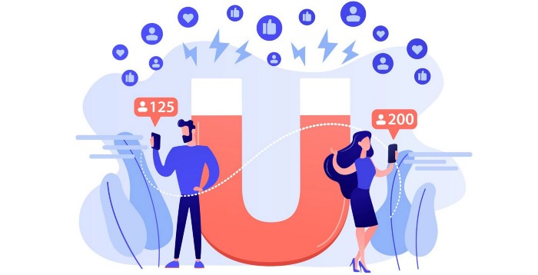
Persuasive Technologies and Behavioral Change
Persuasive technology is broadly defined as technology that is designed to change attitudes or behaviors of the users through persuasion and social influence, but not necessarily through coercion.

Slide 35

Persuasive Technologies and Behavioral Change
Here the emphasis is on changing someone’s habits or doing something that will improve an individual’s well-being through monitoring their behavior.
Persuasive designs may include enticing, cajoling, or nudging someone into doing something through the use of persuasive technology.

Slide 36
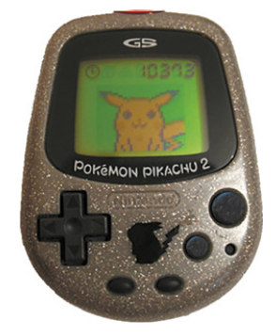
Example- Nintendo’s Pokémon Pikachu (1998)

Slide 37

Example - HAPIfork

Slide 38
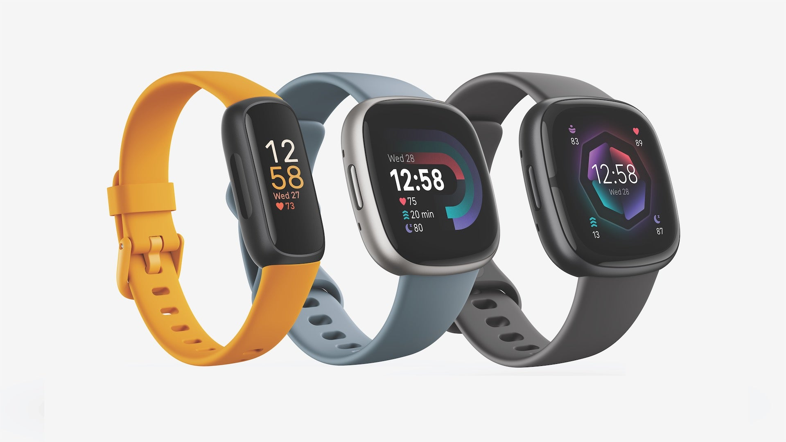
Example - Fitbit

Slide 39
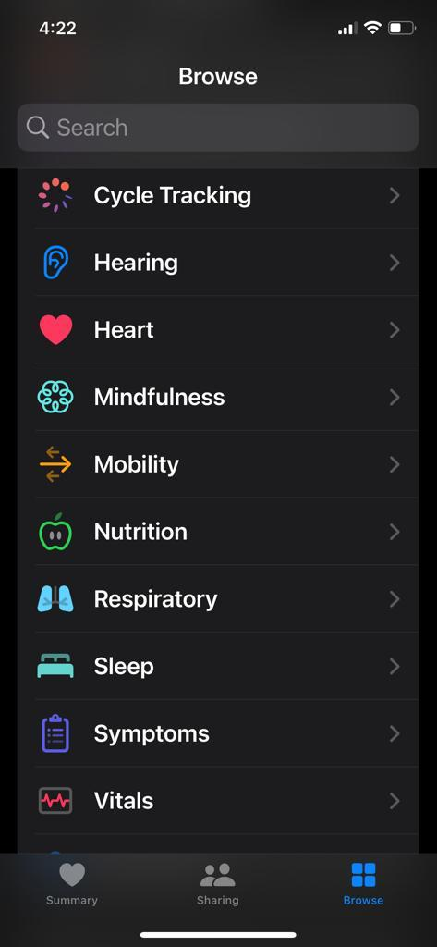
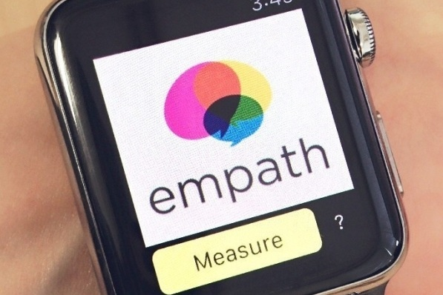
Example – Personalized Apps

Slide 40
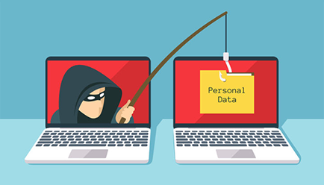
Deceptive Technology
Deceptive phishing is the most common type of phishing scam. In this ploy, fraudsters impersonate a legitimate company to steal people's personal data or login credentials. Those emails use threats and a sense of urgency to scare users into doing what the attackers want.

Slide 41
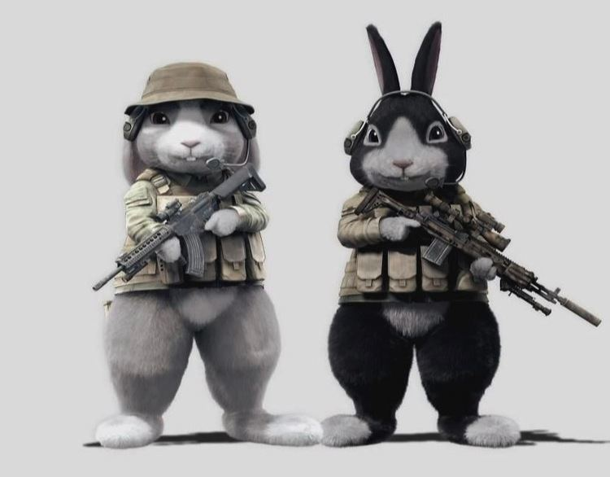
Anthropomorphism
Anthropomorphism is the propensity people have to attribute human qualities to animals and objects.
Toys
Robots
Devices

Slide 42
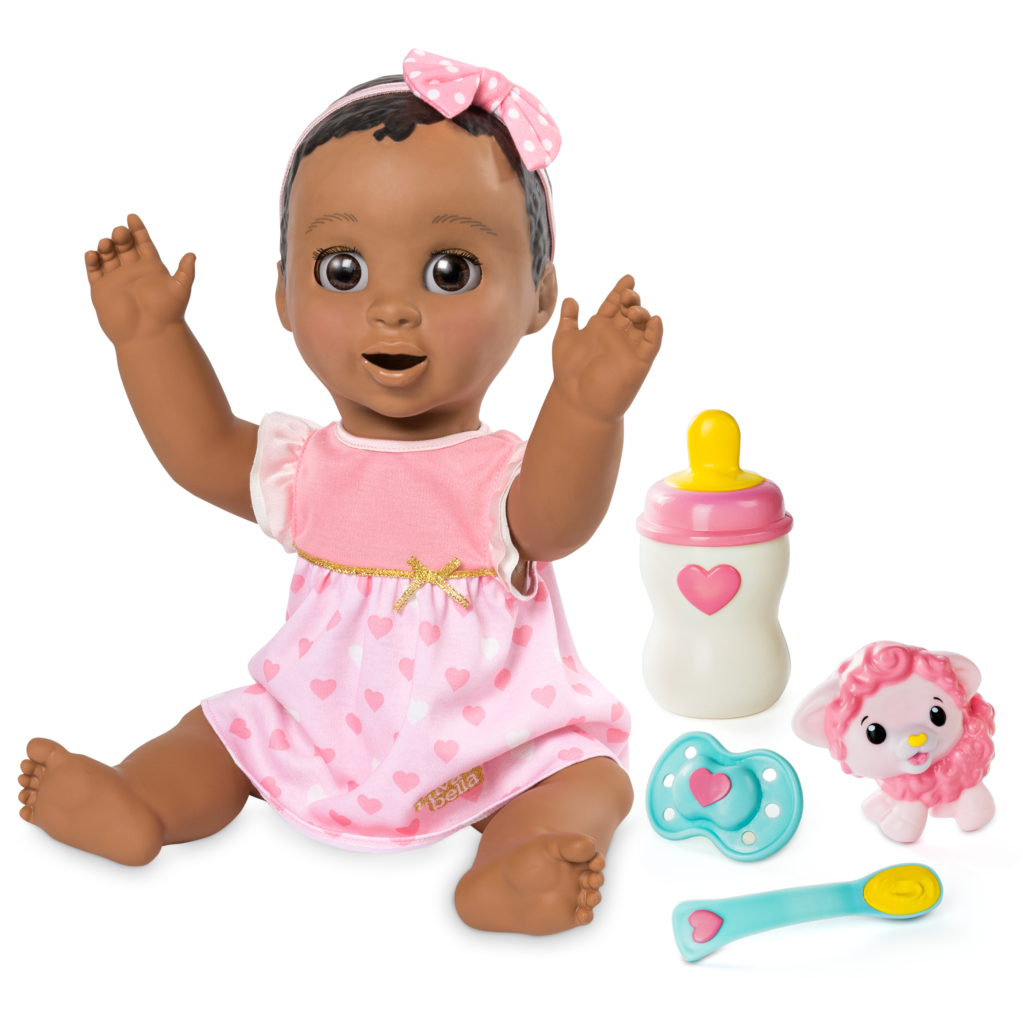
Example – Luvabella
Luvabella | Meet Luvabeau - Only Available at Toys R Us - YouTube

Slide 43
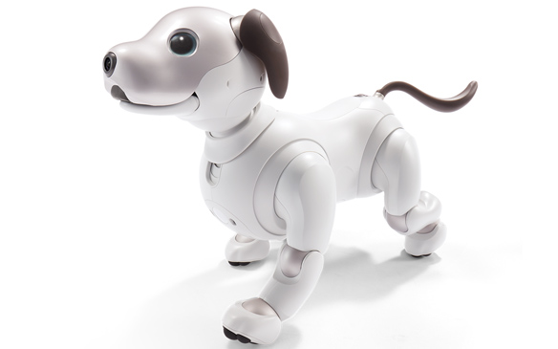
Example – AIBO

Slide 44
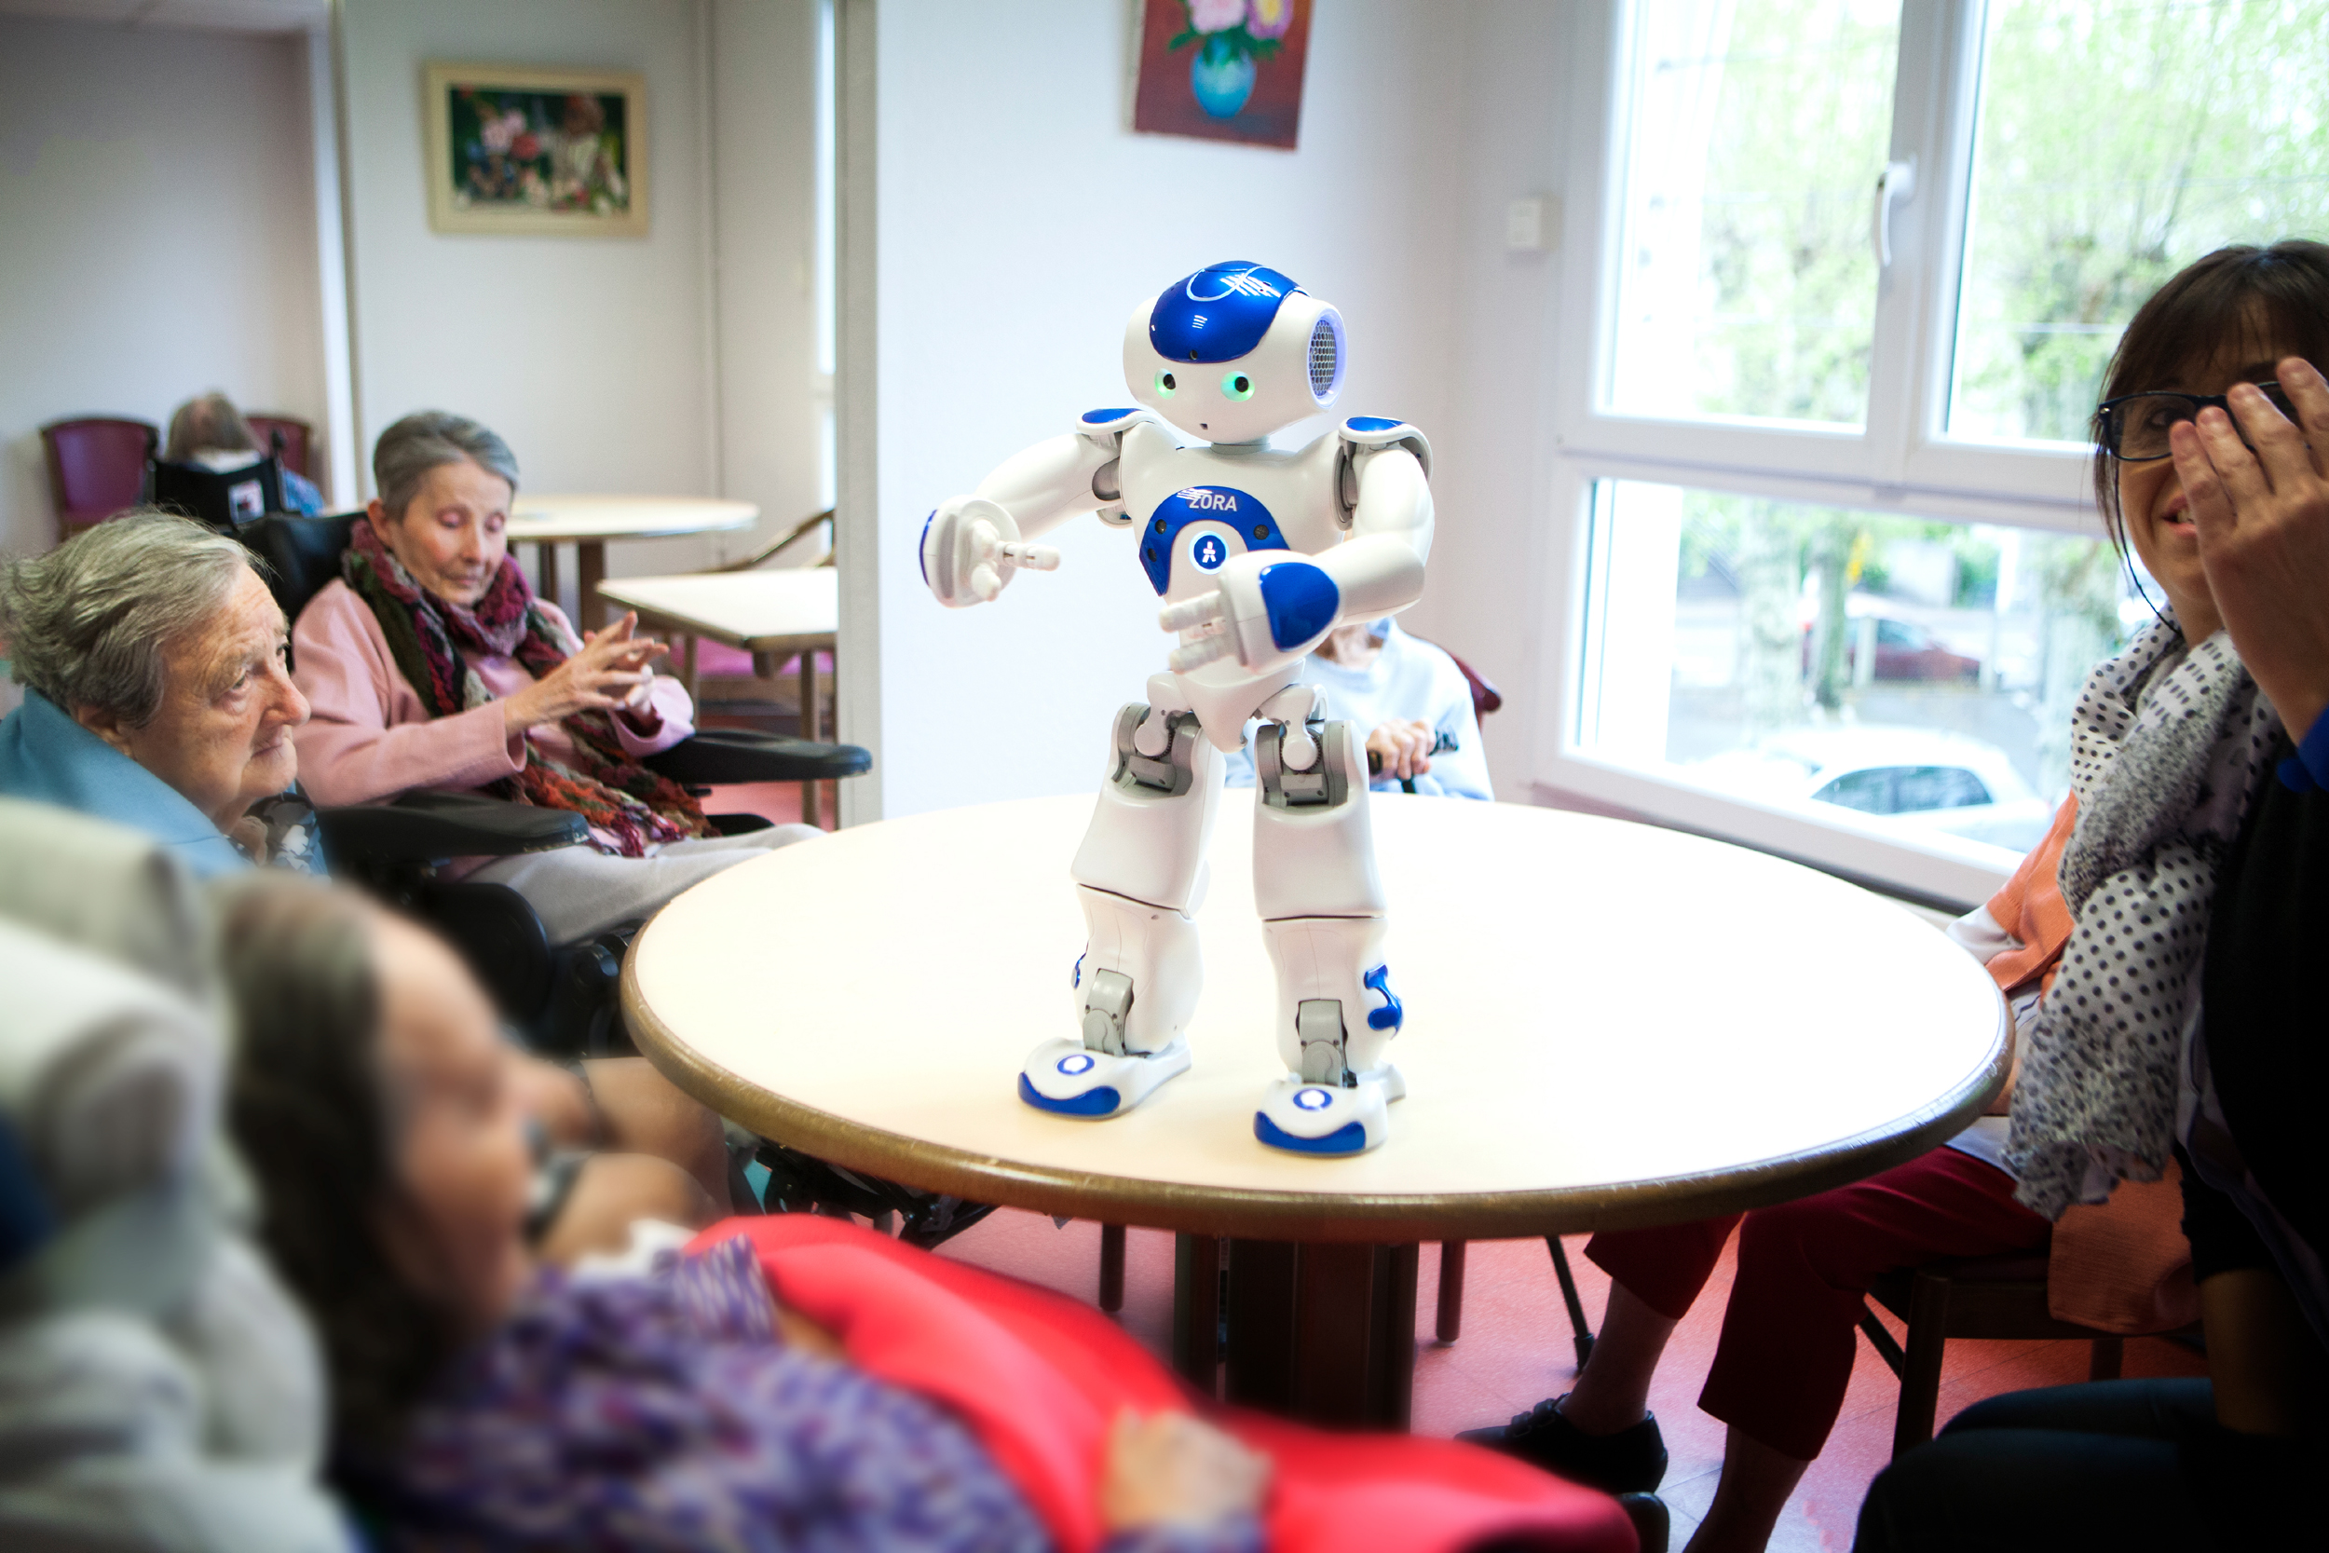
Example - Zora

Slide 45
Conclusion
Emotions and the user experience
Expressive interfaces and emotional design
Annoying interfaces
Effective computing and emotional AI
Persuasive technology and behavior change
Anthropomorphism

